Slide 1
Performance Comparison between MongoDB and MySQL
Pengfei Geng Yuqing Yan Ruizhu Yang pgeng@wpi.edu yyang6@wpi.edu ryang2@wpi.edu

Slide 2
Project overview
Compare MongoDB, one of NoSQL solutions, to MySQL, the traditional SQL relational database.
On Java – Eclipse
The evaluation will compare the differences of managing data and test speed between MongoDB & MySQL
Insert, update, and select operation.
Join
Index

Slide 3
NOSQL
NoSQL could provides a mechanism for storage and retrieval of data that is modeled in means other than the tabular relations used in relational databases.
Benefits:
Large volumes of structured, semi-structured, and unstructured data
Agile sprints, quick iteration, and frequent code pushes
Object-oriented programming that is easy to use and flexible
Efficient, scale-out architecture instead of expensive, monolithic architecture

Slide 4
Environment
Environment: an machine running an Interi5 quad core 3.4GHz processor with 4G of DDR3 Ram.
MySQL: Version 5.6, includeing CLIENT and SERVER
MongoDB: Version 2.6.0
Java driver: mongo-2.10.1.jar

Slide 5
Measurement Set up
People
ID | pname | cid
1 | Mary | 6
2 | Ann | 5
3 | Bob | 8
4 | Rachel | 4
5 | Helen | 3
6 | Steven | 2
7 | Carrie | 1
8 | John | 8
9 | Jim | 4
10 | Zach | 7
City
ID | cname
1 | London
2 | Paris
3 | New York
4 | Boston
5 | Beijing
6 | Worcester
7 | Tokyo
8 | Rome
The number of tuples is about 100, 1000, 10000, and 100000 respectively

Slide 6
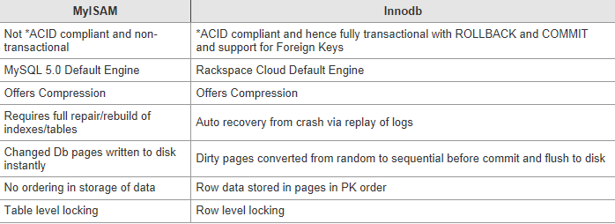
MySQL Engine
Two engine for test:
Myisam
Innodb

Slide 7
Mysqlslap
As the name suggests MySQLslap slaps your MySQL tables with a load of queries at a rate and concurrency that you set.
After the queries have ran it will produce a small table breaking down the times for you, which allows you to easily compare and contrast.

Slide 8
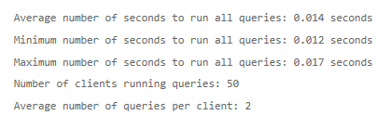
Mysqlslap code
mysqlslap --user=xx --password –auto-generate-sql
mysqlslap -uxx -p --auto-generate-sql --auto-generate-sql-load-type=write --engine=xx --number-of-queries=xx -uxx -p

Slide 9
Innodb & myisam
Comparison
Analysis

Slide 10
Code
statement.executeUpdate("truncate table people");
long a=System.currentTimeMillis();
String sql1 = String.format("insert into people(ID,pname,cid)"+
"values(%d,'Mary',6)",I);
statement.executeUpdate(sql1);
………
long b = System.currentTimeMillis();
System.out.println(“Insert takes" + (b - a) + " ms");

Slide 11
Select comparison with Index
select * from people where pname='John‘
select * from people where cid=1

Slide 12
Update comparison with index
update people set cid=6 where pname='Ann‘
update people set cid=6 where cid=2

Slide 13
Select Join table with(without) index
Select pname,cname from people100 join city where pname='Mary‘
select pname,cname from people100 join city where cid=1

Slide 14
update Join tables with(out) index
Update people join city set cname=‘Seattle’ where pname=‘Bob’
Update people join city set cname=‘Seattle’ where cid=1

Slide 15
MONGOSTAT
The mongostat utility provides a quick overview of the status of a currently running mongod or mongos instance.
Mongostat is functionally similar to the UNIX/Linux file system utility vmstat, but provides data regarding mongod and mongos instances.

Slide 16
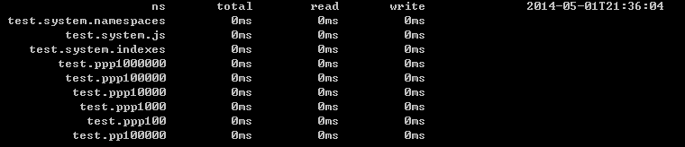
MONGOTOP
Mongotop provides a method to track the amount of time a MongoDB instance spends reading and writing data.
Mongotop provides statistics on a per-collection level.
By default, mongotop returns values every second.

Slide 17
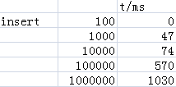
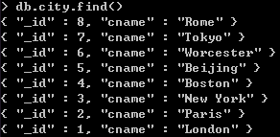

MongoDB insert

Slide 18
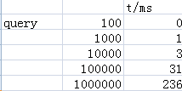
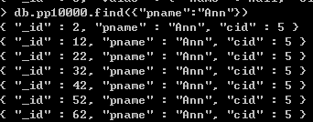
MongoDB query

Slide 19
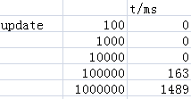
MongoDB update

Slide 20
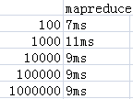
Operation involves two collections
I try to join two collections and operate selection and update.
And I use MapReduce to “join” the two collections. Since we have duplicate documents, the results of mapreduce only have 8 different documents.

Slide 21
Two db comparison query speed

Slide 22
Two db comparison insert speed

Slide 23
Two db comparison update speed

Slide 24
Thank you!

